Slide 1
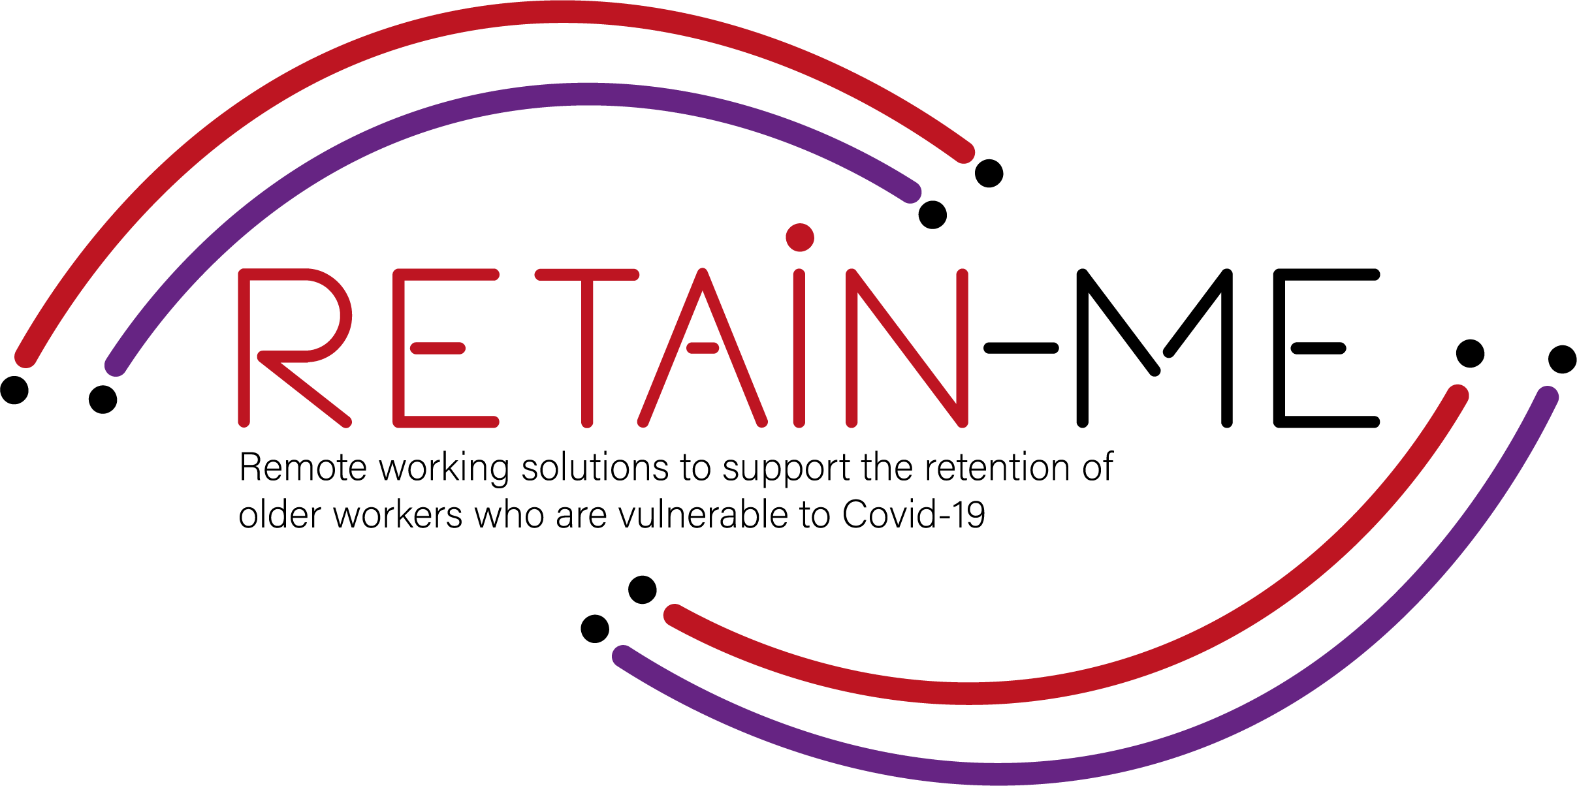
Value Proposition for remote working readiness resources. B-Creative Association

Slide 2
Remote working readiness - Topics
Within RETAIN ME project the following 6 remote working readiness topics will be tackled:
Job-remote working readiness topics:
Ability to work remotely in a team.
Understanding virtual communication.
Development of time management and organisation skills.
4. Understand and development of creative problemsolving.
5. Developing skills for critical thinking
6. Improve ability to apply discipline

Slide 3
Remote working readiness – Value Proposition
It is beneficial to the end users of RETAIN ME project because workers with remote working readiness and knowledge:
... are more aware of different ways of work remotely in a team
... are more of creative problem-solving
... know how to prepare themselves for virtual communication
... know how to think critically
... know the most required skills and knowledge for time management

Slide 4
Remote working readiness – Key Learning Objectives
The key learning objective for the Remote working readiness chapter are:
Participants know how to work remotely in a team
Participants understand virtual communication
Participants understand critical thinking
Participants know how to better organize and manage time
Participants know how to use creative problem-solving
Participants know how to apply discipline

Slide 5
INTRODUCTION
Understand and development of creative problem solving

Slide 6
Definition problem solving
Problem solving is the thought process that an intelligent being uses to solve problems. The problem-solving process, considered the most complex intellectual function, has been studied by psychologists for the past hundred years.

Slide 7
Creative problem solving
When it comes to problem solving, synectics and creativity, the brain is like the tip of an iceberg: we only see a small part of it all.
When this body is faced with a problem, it must solve it. A significant part of the mental processes that lead to this solution are subconscious, and this is where synectics comes into play.
The name synectics comes from the Greek synektikós, which means "to bring together disparate and seemingly irrelevant elements". It is a creative methodology for problem solving.
Furthermore, one of its goals is to take advantage of the characteristics of this type of processing. So, brainstorming and coming up with a method for problem solving based on experience.

Slide 8
In creative problem solving, you combine information and things so that the result is something completely new. This assumes that the individual and the group can think creatively and have creative attitudes and special abilities and skills. Creative problem solving is a process. This process requires noticing the problem or opportunity for improvement and thereby identifying facts and beliefs, setting goals and having visions, devising methods and ideas, evaluating the ideas and choosing a solution and accepting and implementing it.
For more information about to understand and development of creative problem solving, you may visit the following links:
•What is creative problem-solving & why is it important?
https://online.hbs.edu/blog/post/what-is-creative-problem-solving
•Creative problem-solving
https://en.wikipedia.org/wiki/Creative_problem-solving
•The Basics of Creative Problem Solving – CPS
https://innovationmanagement.se/2010/06/02/the-basics-of-creative-problem-solving-cps/
•Use Creative Problem Solving to Build a Remote Work Lifestyle
https://frayedpassport.com/use-creative-problem-solving-to-build-a-remote-work-lifestyle/

Slide 9
ACTIVITY 1
A 7-STEP CPS FRAMEWORK

Slide 10
Through creative problem solving, you will also get the opportunity to develop your personality, i.e., to develop activity, creativity, perseverance and cooperation skills.
This activity have 7 tips for creative problem solving.
Link to resource:
https://innovationmanagement.se/2010/06/02/the-basics-of-creative-problem-solving-cps/

Slide 11
ACTIVITY 2
VIDEOS – WHAT IS CREATIVE PROBLEM SOLVING.

Slide 12
When it comes to developing innovative solutions to unique organizational challenges or your own life, using tried and true methods to brainstorm ideas and find the best possible solution can be a great way to achieve your goals. One such methodology is creative problem solving.
This activity content 3 videos that explaining creative problem solving.

Slide 13
ACTIVITY 3
VIDEOS – WHAT IS CREATIVE PROBLEM SOLVING.

Slide 14
All problem-solving processes start with identifying the problem. Next, the team must assess potential courses of action and choose the best way to tackle the problem. A problem-solving activity helps identify those strengths and builds problem-solving skills and strategies while having fun with your team..
This activity content 2 fun problem-solving activities.
For more activities visit the source: https://www.ntaskmanager.com/blog/top-problem-solving-activities-for-your-team-to-master/

Slide 15
CLOSE & CONCLUSION

Slide 16
Creative problem solving is innovative problem solving. A creative problem solver often finds completely new solutions rather than simply identifying and implementing normal solutions.
“Every problem has a solution. You just have to be creative enough to find it.” - Travis Kalanick
Image by pch.vector on Freepik

Slide 17
"The European Commission's support for the production of this publication does not constitute an endorsement of the contents, which reflect the views only of the authors, and the Commission cannot be held responsible for any use which may be made of the information contained therein.” Project Number: 2021-1-SE01-KA220-VET-000032922

