Slide 1
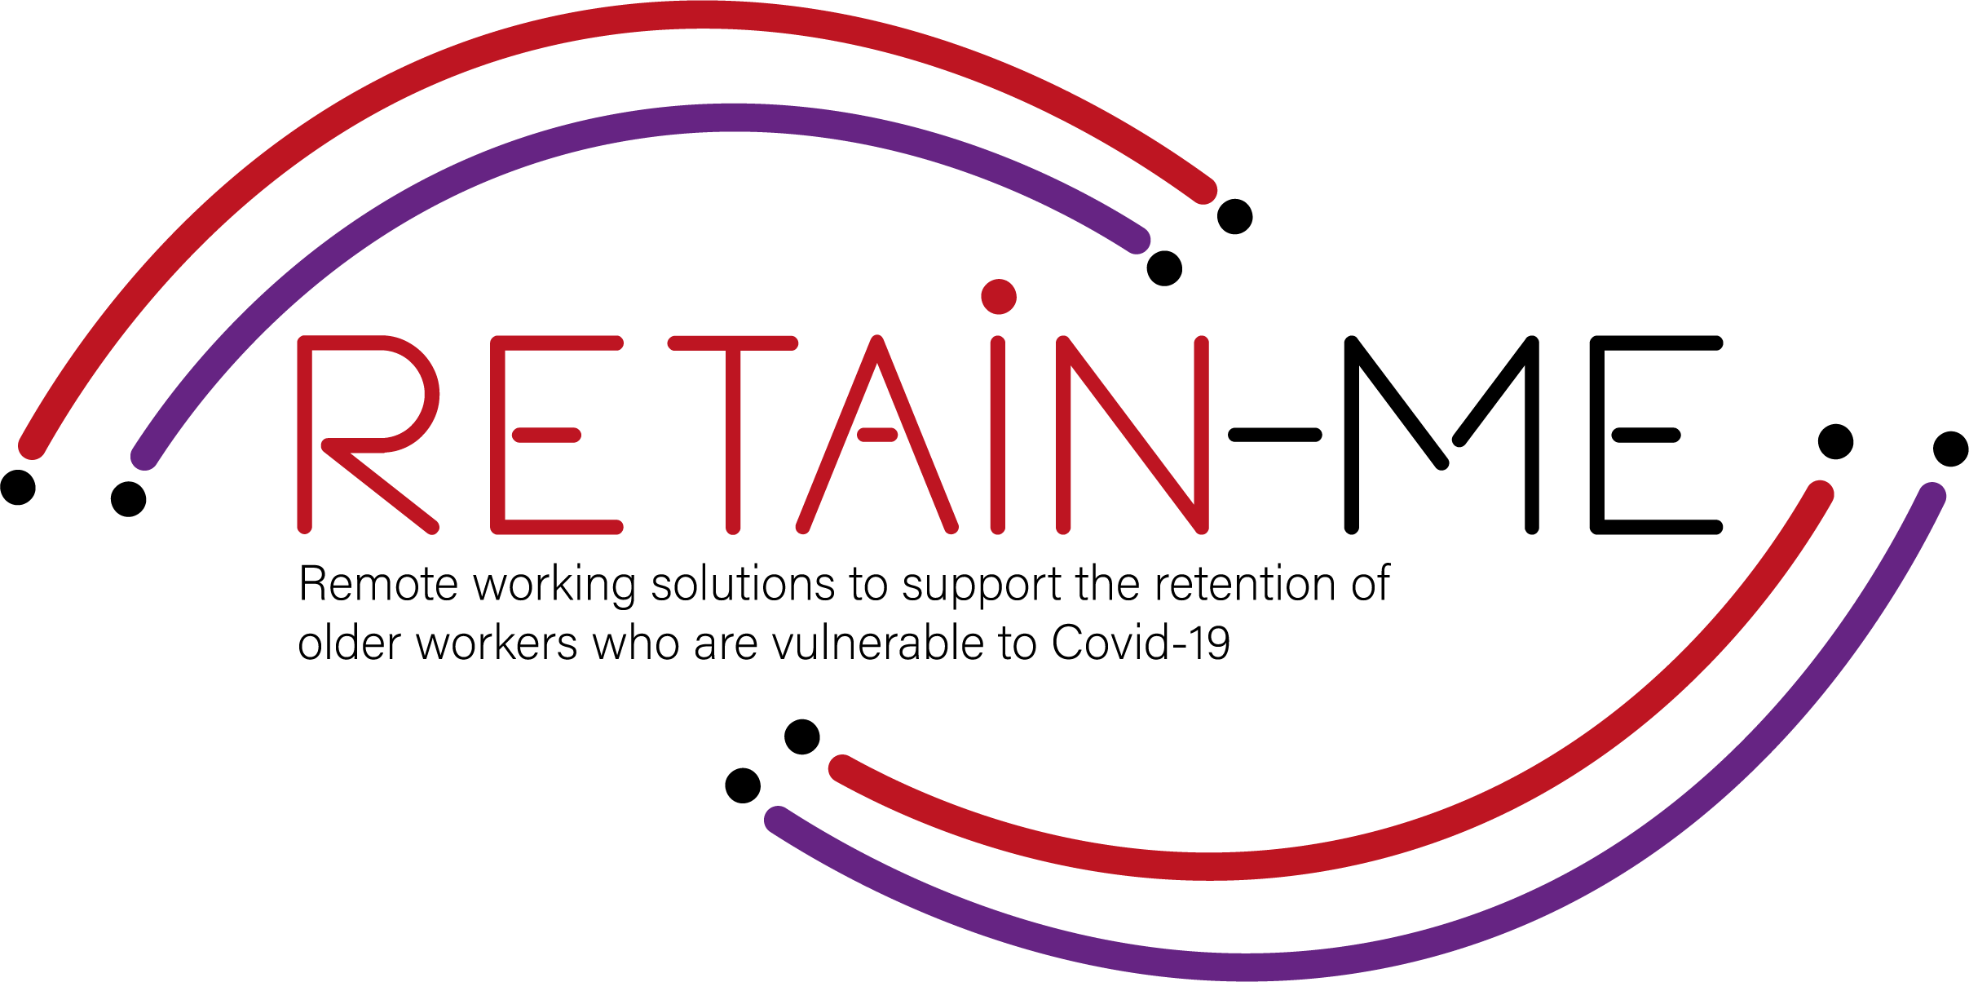
Value Proposition for remote working readiness resources. B-Creative Association

Slide 2
Remote working readiness - Topics
Within RETAIN ME project the following 6 remote working readiness topics will be tackled:
Job-remote working readiness topics:
Ability to work remotely in a team.
Understanding virtual communication.
Development of time management and organisation skills.
4. Understand and development of creative problemsolving.
5. Developing skills for critical thinking
6. Improve ability to apply discipline

Slide 3
Remote working readiness – Value Proposition
It is beneficial to the end users of RETAIN ME project because workers with remote working readiness and knowledge:
... are more aware of different ways of work remotely in a team
... are more of creative problem-solving
... know how to prepare themselves for virtual communication
... know how to think critically
... know the most required skills and knowledge for time management

Slide 4
Remote working readiness – Key Learning Objectives
The key learning objective for the Remote working readiness chapter are:
Participants know how to work remotely in a team
Participants understand virtual communication
Participants understand critical thinking
Participants know how to better organize and manage time
Participants know how to use creative problem-solving
Participants know how to apply discipline

Slide 5
"The European Commission's support for the production of this publication does not constitute an endorsement of the contents, which reflect the views only of the authors, and the Commission cannot be held responsible for any use which may be made of the information contained therein.” Project Number: 2021-1-SE01-KA220-VET-000032922

