Slide 1
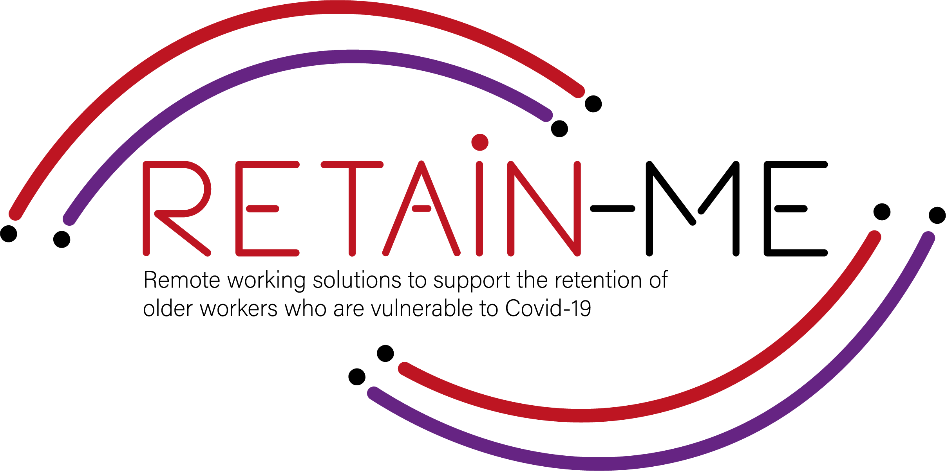
.

Slide 2
Analysing Information Handbook
Hdbchdcbhwdcbdwhc wdhbc hwdc hd chc hc hc hd chdc condhdclhwdbcdhbcw
The ultimate authority must always rest with the individual's own reason and critical analysis”
- Dalai Lama
Here you could describe the topic of the section
Here you could describe the topic of the section
Here you could describe the topic of the section

Slide 3
Analysis Skills
Analysis skills are useful skills in many areas of life, by properly conducting analysis you increase the chances of making the right decision for your remote working career.

Slide 4
Information Overload
In the modern day and age there are billions of pieces of information available to you, not all of this information was created equally however. Having the ability to discern the value of a piece of information is a necessary skill for a remote working career

Slide 5
Acknowledging sources
It is important to analyse the source of information as well as the information itself, some information available online may be purposely misleading to fulfill an ulterior motive, for example information provided by a disgruntled employee may make an organisation seem unattractive to work for but you must remember the source of this information

Slide 6
Developing your Analytical Skills
When conducting analysis on information that you have gathered you will need to combine your knowledge of the subject with a systematic and consistent process that will reliably guide you to the correct decision .

Slide 7
Trust the Process
The key to consistent and reliable analysis outcomes is the process. It’s vital that you develop an analysis process that suits you and that works for you. A rough example of an analysis process would include gathering information, determine accuracy, identify bias, recognize themes and connecting relevant pieces of information.

Slide 8
How to Discern Reliability
Discerning reliability has been mentioned several times in this resource and it’s importance can’t be overstated. If you are analysing unreliable information this will result in unfavourable outcomes which will harm you. The four key steps to judging reliability are Authority, Accuracy, Relevancy and Recency. To learn more about reliability of information visit this site https://www.stevenson.edu/online/about-us/news/how-to-identify-reliable-information

Slide 9
Benefits to you
While we have previously mentioned the benefits of skilled analysis work in finding and performing a role, we haven’t mentioned the benefits to you the employee. An individual that can reliably conduct proper analysis is an extremely valuable asset to an organisation and this will lead to higher wages and better working conditions for you the skilled individual.

Slide 10
Further research
If you’re interested in learning more about the credibility and reliability of information forbes.com have created some helpful tips right here https://www.forbes.com/sites/averyblank/2021/01/19/5-ways-to-identify-reliable-sources-and-maintain-your-credibility/?sh=232e736f5aa9

Slide 11
"The European Commission's support for the production of this publication does not constitute an endorsement of the contents, which reflect the views only of the authors, and the Commission cannot be held responsible for any use which may be made of the information contained therein.” Project Number: 2021-1-SE01-KA220-VET-000032922

