Slide 1
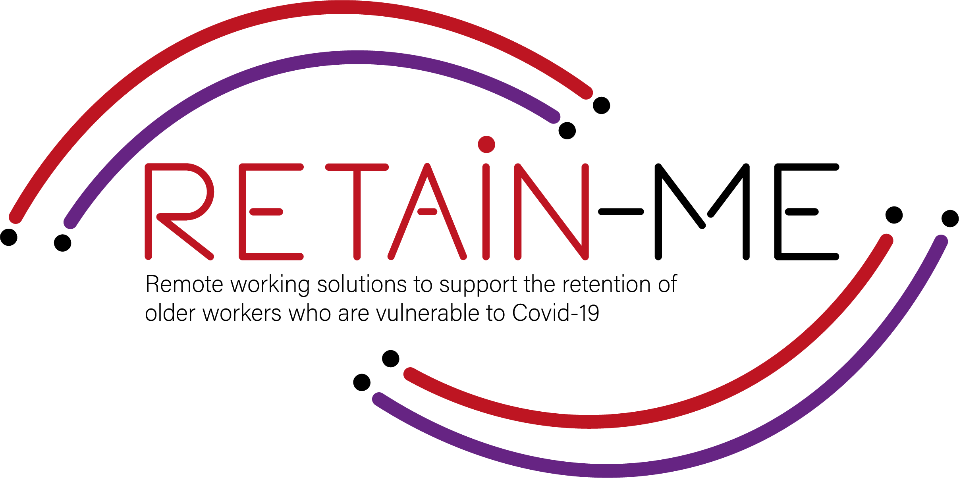
Value Proposition for remote working readiness resources. B-Creative Association

Slide 2
Remote working readiness - Topics
Within RETAIN ME project the following 6 remote working readiness topics will be tackled:
Job-remote working readiness topics:
Ability to work remotely in a team.
Understanding virtual communication.
Development of time management and organisation skills.
4. Understand and development of creative problemsolving.
5. Developing skills for critical thinking
6. Improve ability to apply discipline

Slide 3
Remote working readiness – Value Proposition
It is beneficial to the end users of RETAIN ME project because workers with remote working readiness and knowledge:
... are more aware of different ways of work remotely in a team
... are more of creative problem-solving
... know how to prepare themselves for virtual communication
... know how to think critically
... know the most required skills and knowledge for time management

Slide 4
Remote working readiness – Key Learning Objectives
The key learning objective for the Remote working readiness chapter are:
Participants know how to work remotely in a team
Participants understand virtual communication
Participants understand critical thinking
Participants know how to better organize and manage time
Participants know how to use creative problem-solving
Participants know how to apply discipline

Slide 5
INTRODUCTION
Development of time management and organization skills

Slide 6
Time Management
Why is Remote Work Time Management Important?
Time management is one of the most important and difficult to manage aspects of remote work. When done right, remote work offers tremendous flexibility and increased productivity. However, poor time management can also make your remote environment very stressful and isolating at times. You might struggle to balance your work responsibilities with your personal ones. This is exactly why it’s important to be in control of your own workday in a home office.
Time management is a challenge during normal times, but when working remotely, it can be tougher without the parameters you’re accustomed to when you’re in the office.
Sometimes it feels like there isn't enough time and we've all probably put in some extra work hours in the evenings and weekends. Through Time management, you can learn to work smarter and get more out of your time, both at work and in your free time.

Slide 7
Organisation Skills
To properly organize your working day, start and finish work remotely at a strictly allotted time, take a food break and get up from your chair to warm up. Also, experts recommend not to stay in your pyjamas while working, even if none of your colleagues can see you.
Organize your workplace, when you work from a bed or sofa, it is not a good solution. It would be best to take care of your personal space, ideally an office where no one will interrupt you. Make sure you have a comfortable desk and chair to work with. Set up all the devices you need and connect to the most convenient and reliable internet.
To make it easier to organise your work It's good that you and your team have a clear plan of tasks, according to which you can work and, for example, at the end of the day, call the whole team and check where each of you is now.

Slide 8
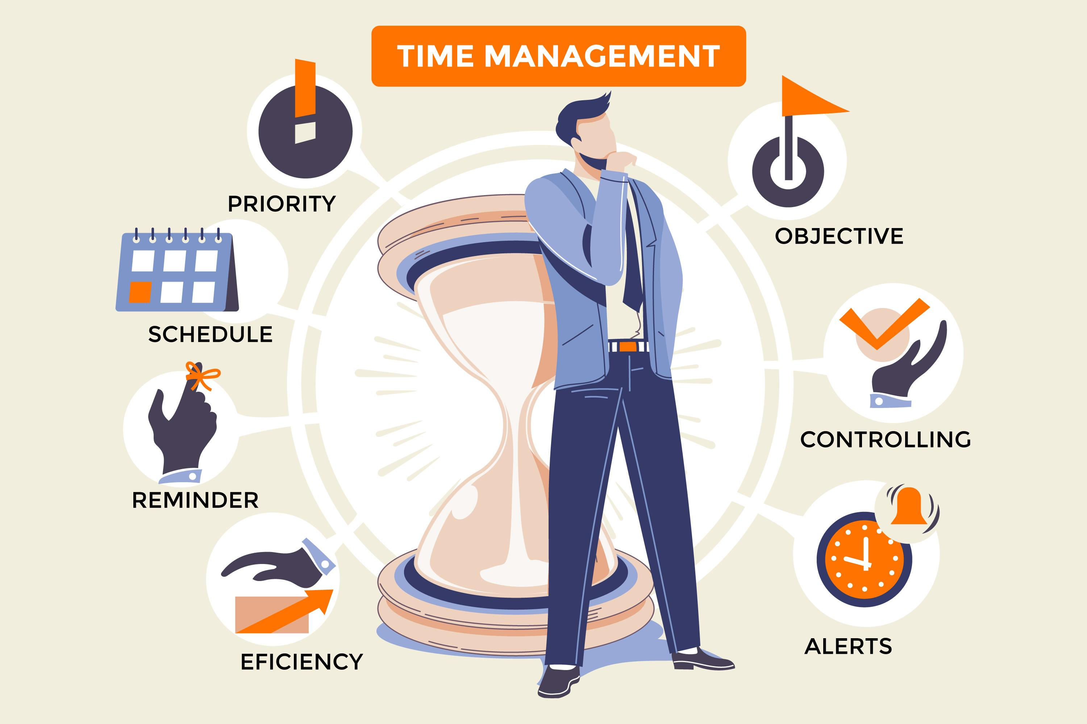
“The bad news is time flies. The good news is you’re the pilot” - Michael Altshuler

Slide 9
ACTIVITY 1
7 TIPS FOR TIME MANAGEMENT

Slide 10
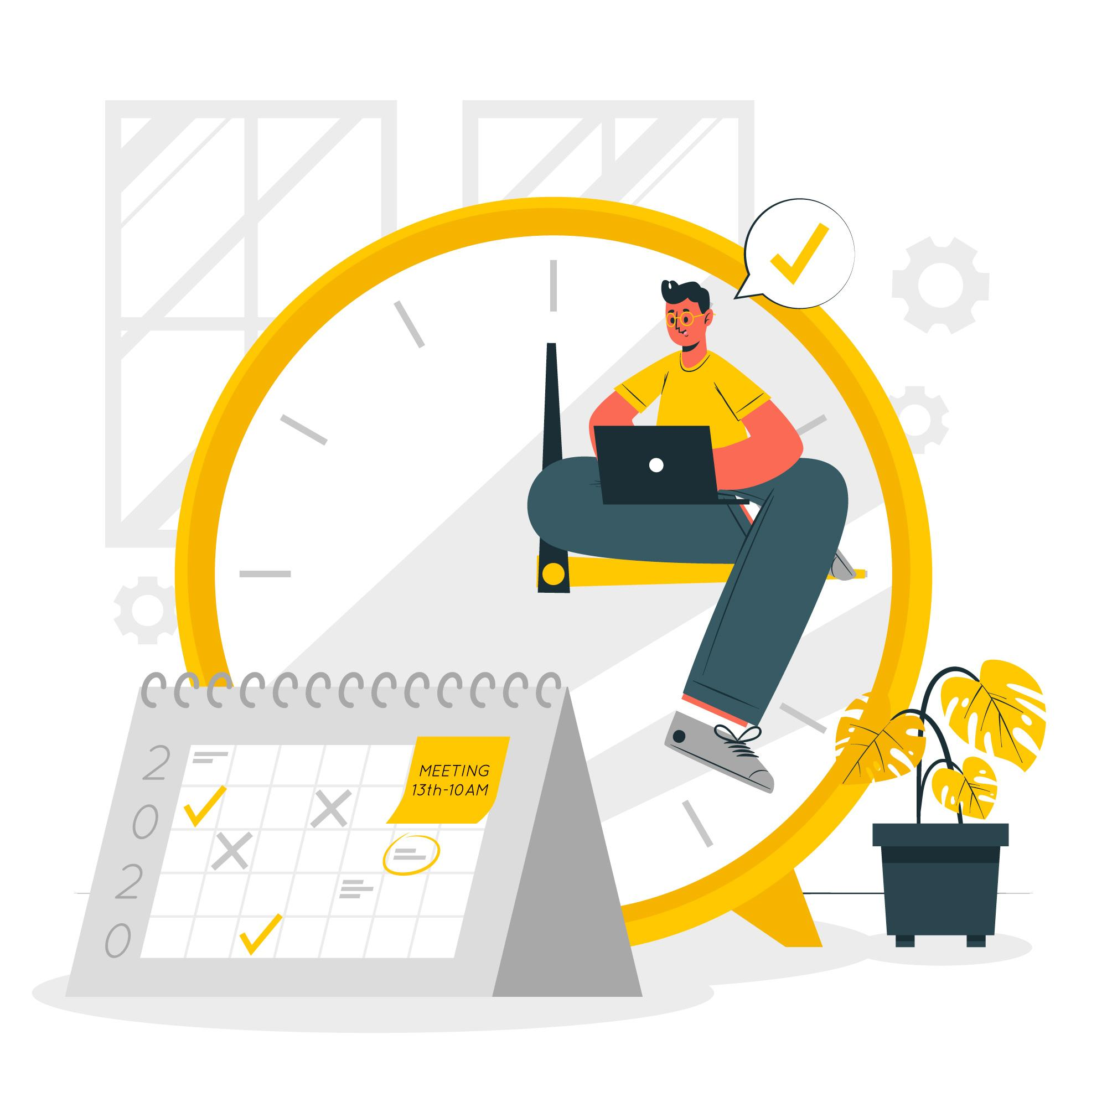
As soon as you start working remote you become completely responsible for all your time – from how you spend and structure it, to how you keep it accountable and balanced.
In this activity you well get some tips for time management for remote work.
Image by storyset on Freepik

Slide 11
ACTIVITY 2
TEST TO IDENTIFY ORGANIZATIONAL SKILLS

Slide 12
An activity that you should answer some questions to determine your organizational skills, i.e. the ability to actively influence people.
Example of questions
1. How often do you manage to win over most of your peers to your side?
2. Are you good at navigating a critical situation?
3. Do you enjoy doing community work?

Slide 13
CLOSE & CONCLUSION

Slide 14
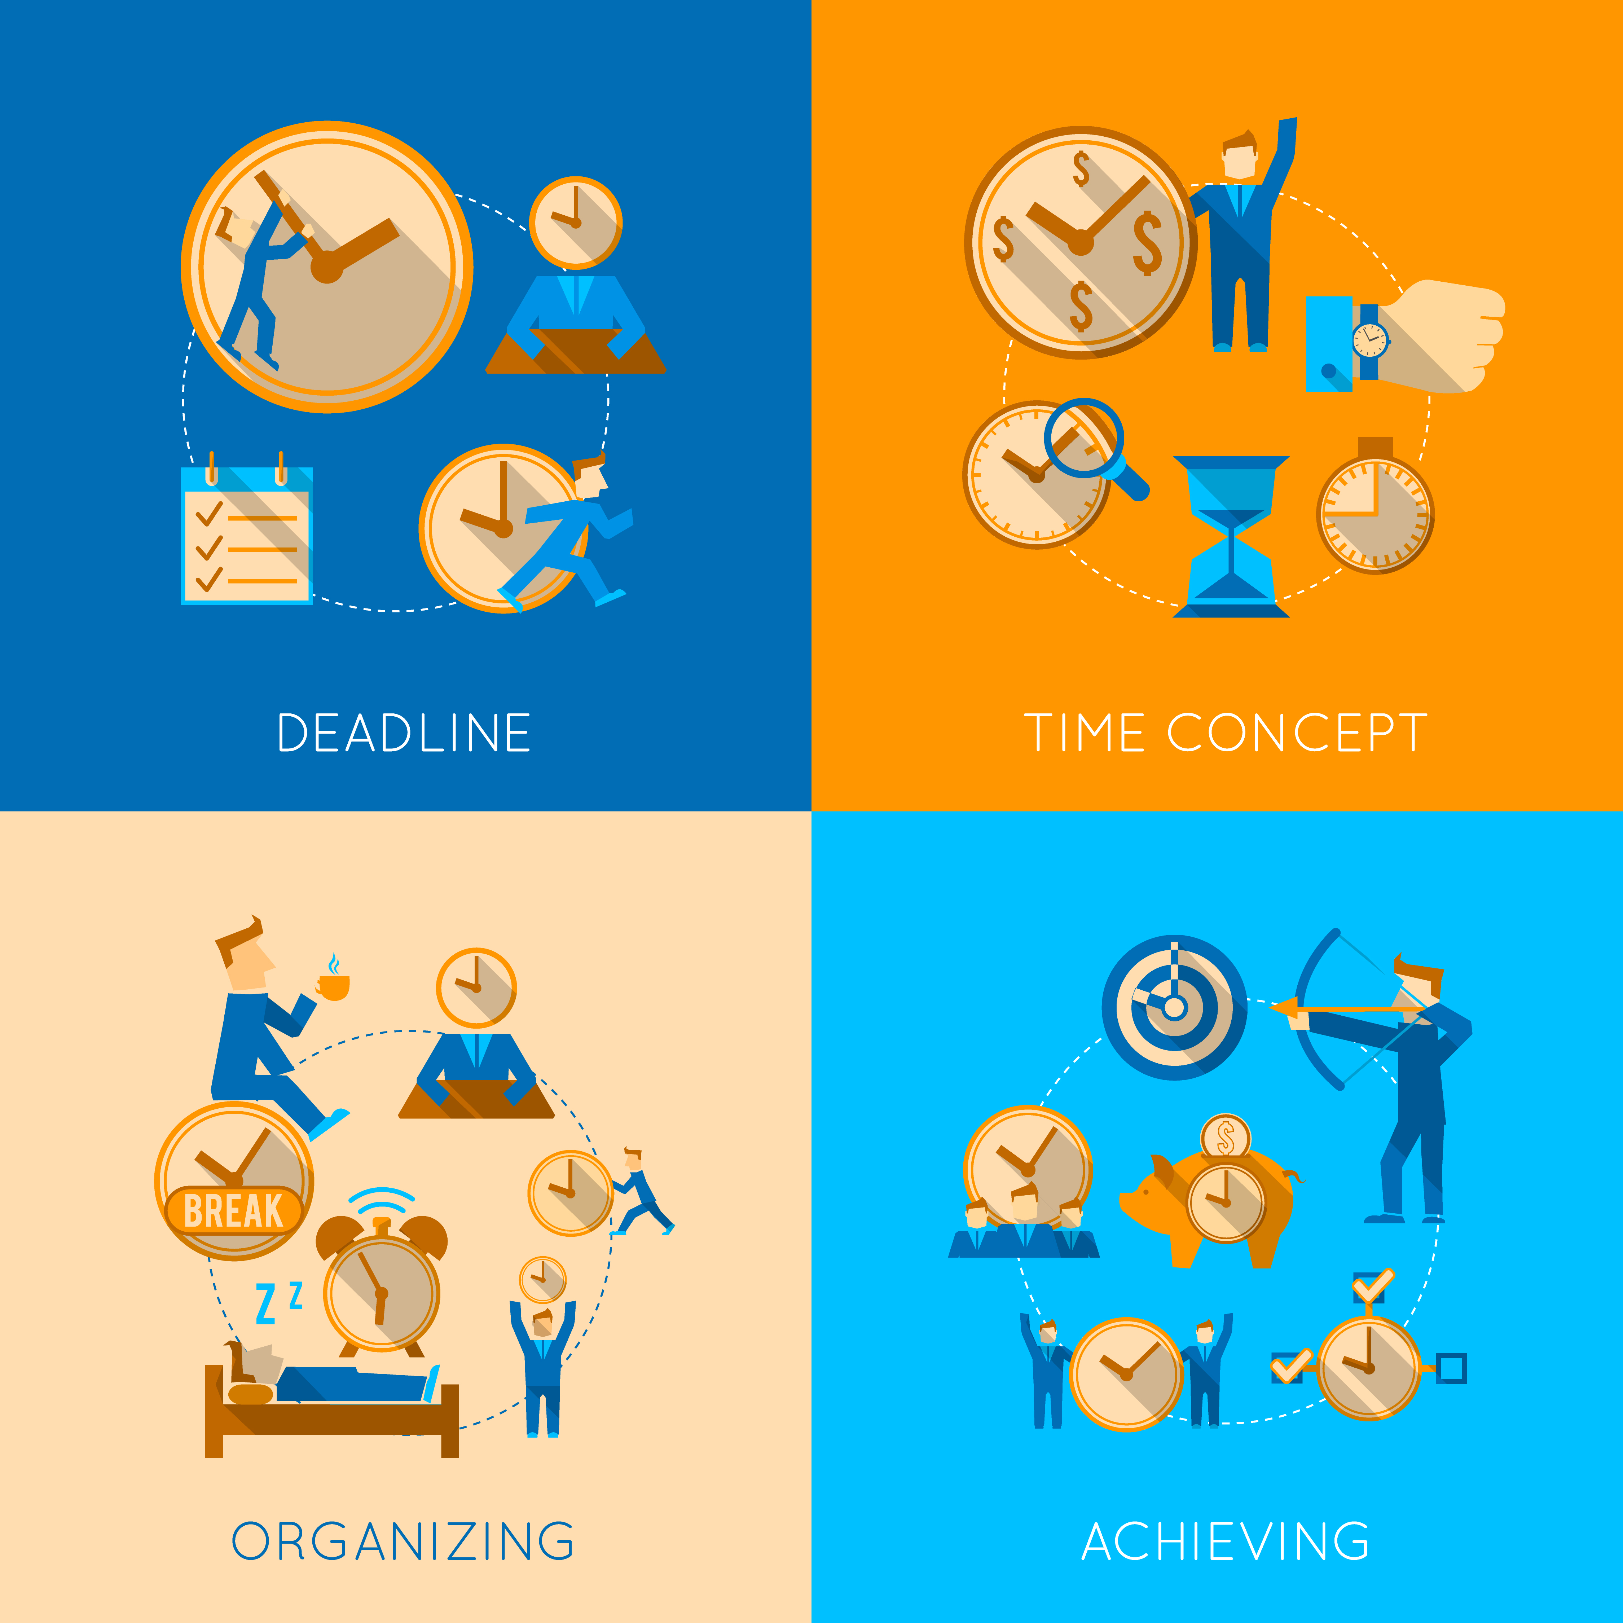
Overall, understanding the importance of soft skills such as time management and organization skills in personal and professional growth is the first step to long-term remote job advancement. Soft skills often reflect your ability to work with others and progress within an organization.
Image by macrovector_official on Freepik

Slide 15
"The European Commission's support for the production of this publication does not constitute an endorsement of the contents, which reflect the views only of the authors, and the Commission cannot be held responsible for any use which may be made of the information contained therein.” Project Number: 2021-1-SE01-KA220-VET-000032922

