Slide 1
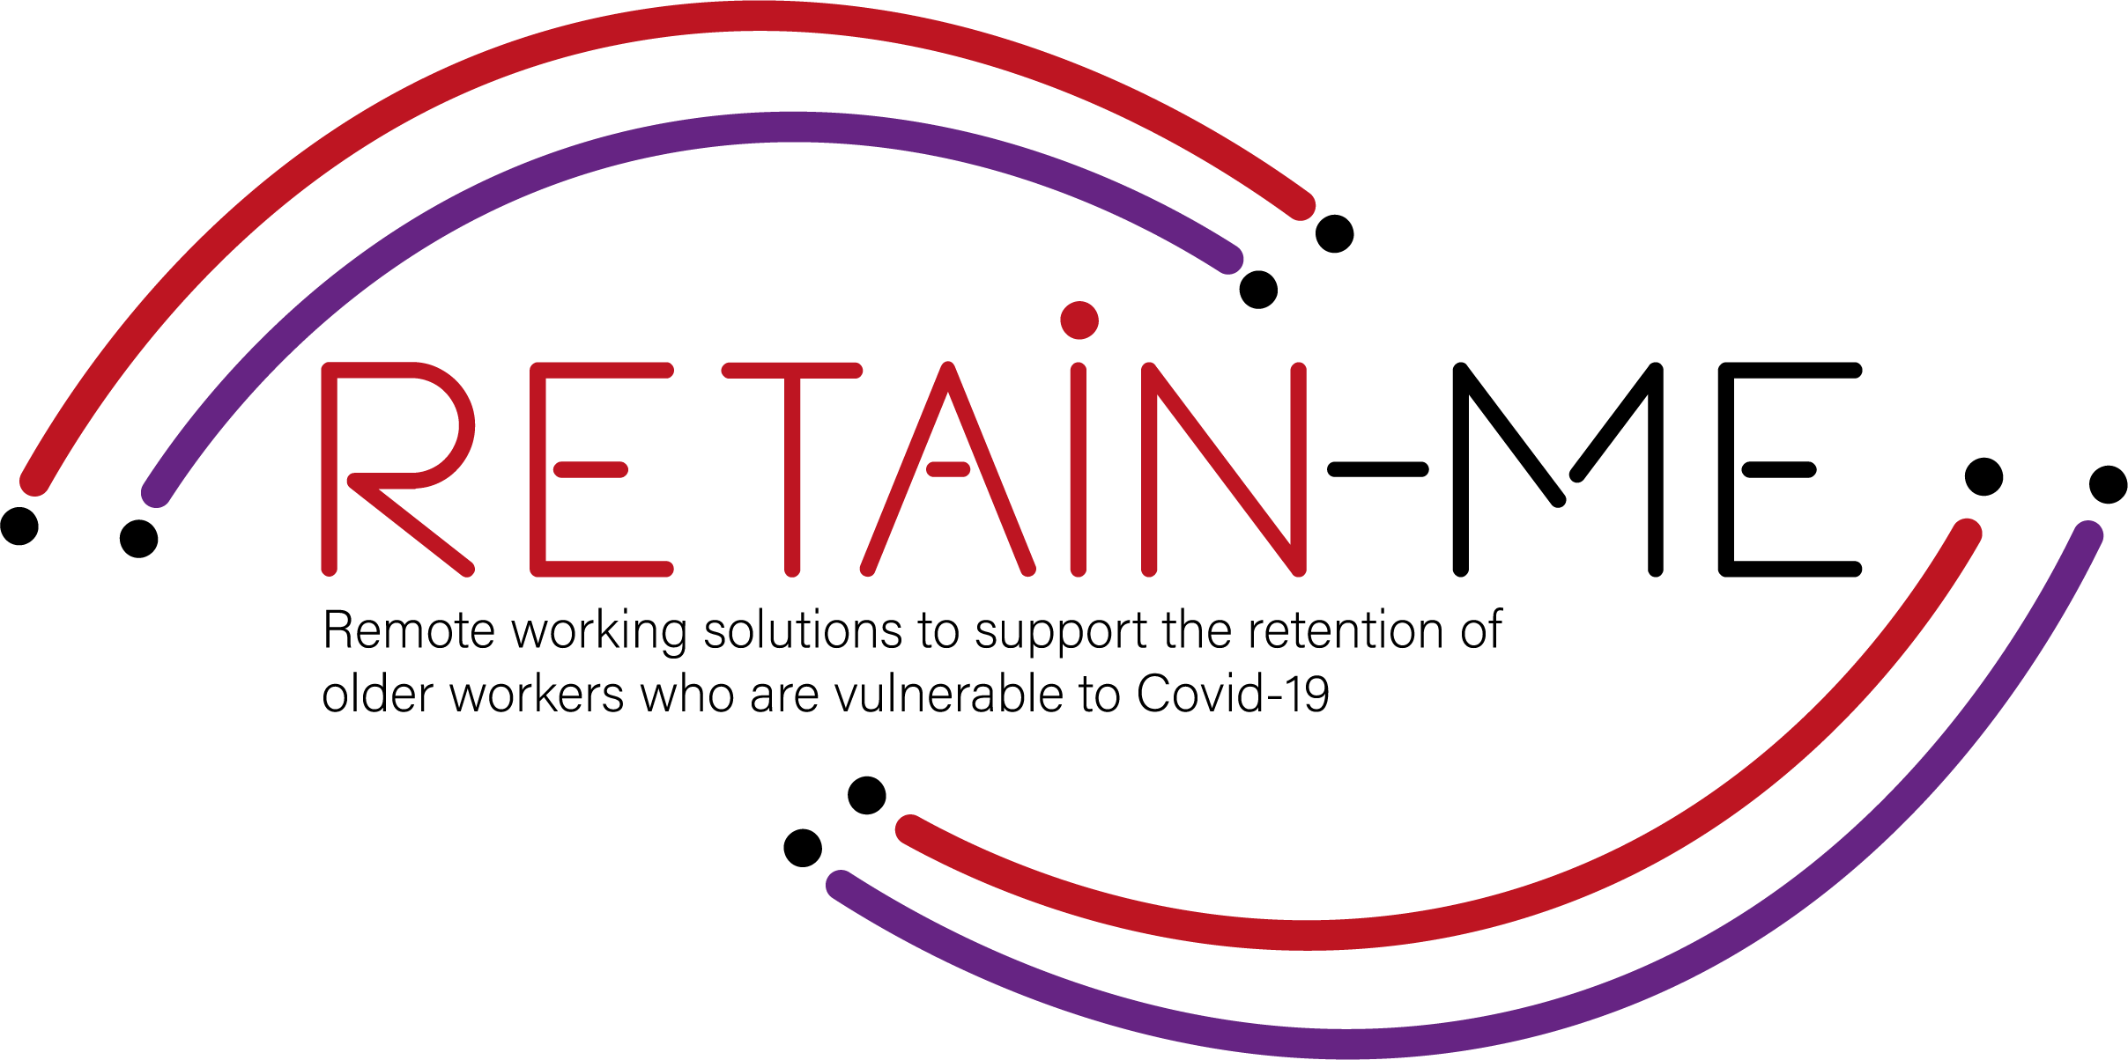
Value Proposition for remote working readiness resources. B-Creative Association

Slide 2
Remote working readiness - Topics
Within RETAIN ME project the following 6 remote working readiness topics will be tackled:
Job-remote working readiness topics:
Ability to work remotely in a team.
Understanding virtual communication.
Development of time management and organisation skills.
4. Understand and development of creative problemsolving.
5. Developing skills for critical thinking
6. Improve ability to apply discipline

Slide 3
Remote working readiness – Value Proposition
It is beneficial to the end users of RETAIN ME project because workers with remote working readiness and knowledge:
... are more aware of different ways of work remotely in a team
... are more of creative problem-solving
... know how to prepare themselves for virtual communication
... know how to think critically
... know the most required skills and knowledge for time management

Slide 4
Remote working readiness – Key Learning Objectives
The key learning objective for the Remote working readiness chapter are:
Participants know how to work remotely in a team
Participants understand virtual communication
Participants understand critical thinking
Participants know how to better organize and manage time
Participants know how to use creative problem-solving
Participants know how to apply discipline

Slide 5
INTRODUCTION
Understanding virtual communication

Slide 6
We define virtual communication as a mode of communication that includes the use of technology - audio and video to communicate with people who are not physically present in front of us. People can be in the next room, other floor, in neighborhood or even miles away. Although virtual communication started way back with the invention of telephone, the advent of webcams, video conferencing and instant communications, which made virtual communication a big hit. Today we use virtual communication in almost every work of life within family, friends, and office to name a few.

Slide 7
Effective communication
Effective communication is important within a virtual team. Open, honest communication not only helps you to avoid misunderstandings, but it will also increase your effectiveness.
It’s crucial to get communication right when you’re working remotely.
Why? Because virtual communication has a huge impact on productivity. When your team knows how to communicate well, they can get work done without waiting hours for a response. Plus, poor communication between remote teams increases the chances of things going wrong.

Slide 8
Rules for better communication in virtual teams
Say “good morning”
One of the biggest transitions employees face when working remotely is the lack of human interaction and the lack of structure.
A good place to start? Say “good morning” to each other and make time to chat over your morning coffee. It’ll help your remote team feel a little less remote.
Build trust in person and grow that trust with clear expectations. In order for people to work effectively virtually, there has to be trust. Trust doesn't happen magically. It is built when you bring your team together for training or team building, and then continues to grow with clear expectations consistently set by leaders and met by the team.
Try to listen actively when someone else is speaking, and never attempt to multitask. Give the other person your full attention – this is a sign of respect, and you'll understand them better, too.

Slide 9
ACTIVITY 1
5 tips for effective communication when your employees work from home

Slide 10
In today's digital workplaces, many are already used to working from home or remotely, but for others it is a new experience that takes a while to get used to. What can you as a manager and employer do to ensure effective communication and keep team spirit up?
In this activity you will get 5 tips for communicating with your employees remotely, creating cohesion and keeping productivity up.
https://blog.benify.se/5-tips-for-effektiv-kommunikation-nar-dina-anstallda-jobbar-hemifran (SE)

Slide 11
ACTIVITY 2
Two truths and a lie

Slide 12
Activity: Two truths and a lie
A fun activity :
This is a way to get an effective communication through a game that also is a good team-building activity.

Slide 13
CLOSE & CONCLUSION

Slide 14
With so many options of virtual communication tools available within a click, it definitely makes our lives easier. Nowadays, the ability of communicating virtually and instantly or sharing our information in seconds is very crucial. Virtual communication is creating a communication environment which is cost-effective, time-saving and accessible 24/7. Communication has evolved in the last few decades and very soon, virtual communication will be the base of communication in future. We will see a range of new products and technologies which will assist in making our virtual communication easier and quicker.
With many advantages and features, people across the world have access to multiple virtual communication tools, which is making their life easy and comfortable.

Slide 15
"The European Commission's support for the production of this publication does not constitute an endorsement of the contents, which reflect the views only of the authors, and the Commission cannot be held responsible for any use which may be made of the information contained therein.” Project Number: 2021-1-SE01-KA220-VET-000032922

