Slide 1
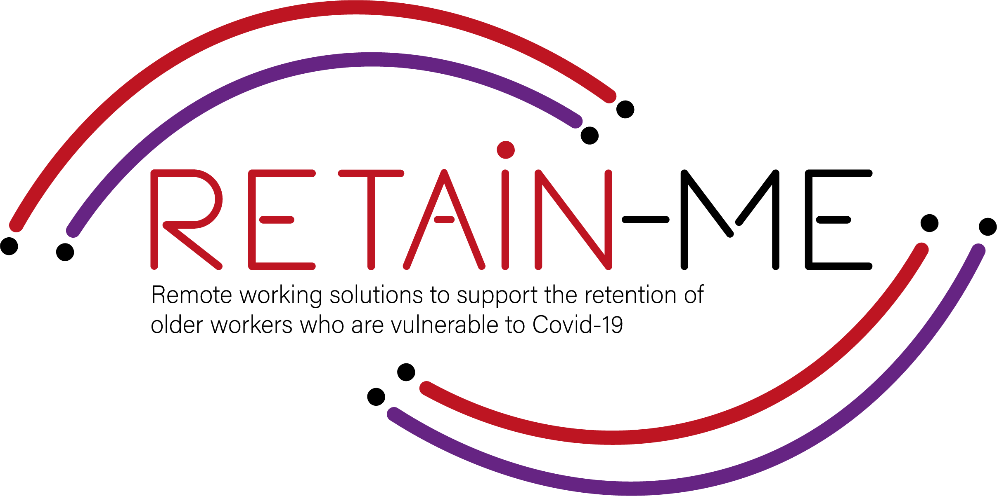
Value Proposition for remote working readiness resources. B-Creative Association

Slide 2
Remote working readiness - Topics
Within RETAIN ME project the following 6 remote working readiness topics will be tackled:
Job-remote working readiness topics:
Ability to work remotely in a team.
Understanding virtual communication.
Development of time management and organisation skills.
4. Understand and development of creative problemsolving.
5. Developing skills for critical thinking
6. Improve ability to apply discipline

Slide 3
Remote working readiness – Value Proposition
It is beneficial to the end users of RETAIN ME project because workers with remote working readiness and knowledge:
... are more aware of different ways of work remotely in a team
... are more of creative problem-solving
... know how to prepare themselves for virtual communication
... know how to think critically
... know the most required skills and knowledge for time management

Slide 4
Remote working readiness – Key Learning Objectives
The key learning objective for the Remote working readiness chapter are:
Participants know how to work remotely in a team
Participants understand virtual communication
Participants understand critical thinking
Participants know how to better organize and manage time
Participants know how to use creative problem-solving
Participants know how to apply discipline

Slide 5
INTRODUCTION
Improve ability to apply discipline

Slide 6
What is self-discipline?
One definition is: "The ability to do what you need to do, when you need to do it, whether you feel like it or not."
Self-discipline is about, among other things, precisely the ability to postpone or forego an immediate reward. After you have done the hard and necessary work, you will reap bigger and better fruits. You will probably also respect yourself more, your self-esteem increases, you feel proud. Research and studies have shown that those who have the discipline to postpone or forgo an immediate reward in order to instead get something better later in time are usually the most successful.

Slide 7
Self-discipline is something you can learn - it's not innate.
That's why you can laugh the next time someone says he/she is self-disciplined. The fact is that one cannot be self-disciplined. One can use self-discipline, but one cannot be self-disciplined as if it were an innate quality. Even those who seem to be good at self-discipline also have issues with that little person inside them who takes over sometimes. The reason for that is that no matter how good you are at self-discipline, there is always room for improvement. Self-discipline is thus something you can learn and practice every day.

Slide 8
Self-discipline
As a remote worker, you must put more effort into staying focused. From frequent interruptions from family and friends to noisy neighbors to the strong urge to jump back to bed, there are myriads of distractions around you, and it can be tough to maintain the level of productivity you show in the 9-5 office setting.
That’s why it’s important to learn how to discipline yourself when working from home.
Self-discipline encourages us to do activities we should be doing, even when we don’t feel like doing them. That way, self-discipline helps us be more consistent so that we can achieve greater goals.

Slide 9
ACTIVITY 1
HOW TO IMPROVE SELF-DISCIPLINE WHEN WORKING REMOTELY

Slide 10
As a remote worker, you have to put more effort into staying focused. From frequent interruptions from family and friends to noisy neighbours to the strong urge to jump back to bed, there are myriads of distractions around you, and it can be tough to maintain the level of productivity you show in the 9-5 office setting.
That’s why it’s important to learn how to discipline yourself when working from home.
In this activity there are tips to get more disciplined.

Slide 11
ACTIVITY 2
FIVE EFFECTIVE WAYS TO GAIN MORE SELF-DISCIPLINE

Slide 12
There are five distinguishing characteristics of the people who have self-discipline: self-awareness, awareness, commitment, courage and the ability to motivate oneself.
You can learn to be more self-disciplined by practicing these sides of yourself.
In this activity you can learn more about how to gain more self- discipline.

Slide 13
CLOSE & CONCLUSION

Slide 14
The most significant traits of a self-disciplined person are responsibility, persistence, strong work ethic, and self-care. Even if you don’t feel like you check all these boxes, be sure that developing your self-discipline is possible.
This process starts with self-control exercises. Besides, other ways to enhance your self-discipline are avoiding multitasking and distractions, as well as creating a productive environment for yourself.
Furthermore, making sure that you’re disciplined is especially important when working from home. In that case, you should try to stick to your working hours at home, and always make plans for the day ahead of you.

Slide 15
"The European Commission's support for the production of this publication does not constitute an endorsement of the contents, which reflect the views only of the authors, and the Commission cannot be held responsible for any use which may be made of the information contained therein.” Project Number: 2021-1-SE01-KA220-VET-000032922

