Slide 1
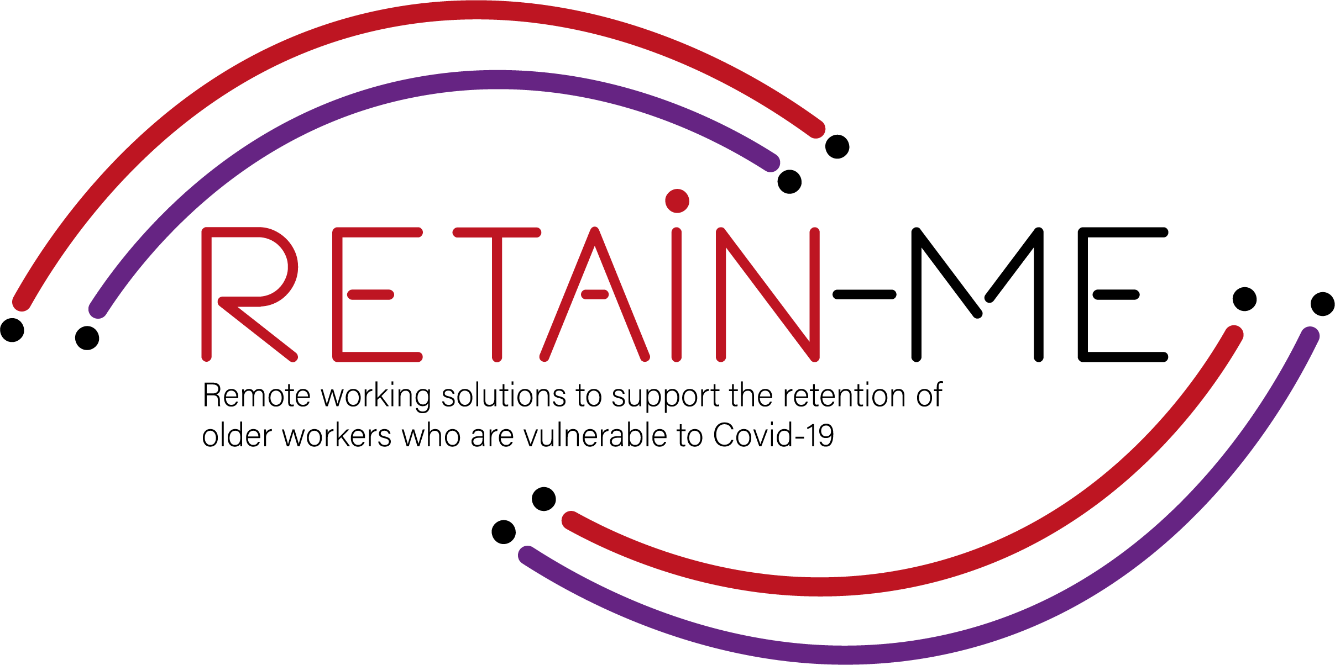
Value Proposition for remote working readiness resources. B-Creative Association

Slide 2
Remote working readiness - Topics
Within RETAIN ME project the following 6 remote working readiness topics will be tackled:
Job-remote working readiness topics:
Ability to work remotely in a team.
Understanding virtual communication.
Development of time management and organisation skills.
4. Understand and development of creative problemsolving.
5. Developing skills for critical thinking
6. Improve ability to apply discipline

Slide 3
Remote working readiness – Value Proposition
It is beneficial to the end users of RETAIN ME project because workers with remote working readiness and knowledge:
... are more aware of different ways of work remotely in a team
... are more of creative problem-solving
... know how to prepare themselves for virtual communication
... know how to think critically
... know the most required skills and knowledge for time management

Slide 4
Remote working readiness – Key Learning Objectives
The key learning objective for the Remote working readiness chapter are:
Participants know how to work remotely in a team
Participants understand virtual communication
Participants understand critical thinking
Participants know how to better organize and manage time
Participants know how to use creative problem-solving
Participants know how to apply discipline

Slide 5
INTRODUCTION
Developing skills for critical thinking

Slide 6
What are the basics of critical thinking?
Critical thinking is the intellectually disciplined process of actively and skillfully conceptualizing, applying, analyzing, synthesizing, and/or evaluating information gathered from, or generated by, observation, experience, reflection, reasoning, or communication, as a guide to belief and action.
Image by storyset on Freepik

Slide 7
Is critical thinking a skill?
Critical thinking is the analysis of an issue or situation and the facts, data, or evidence related to it. Critical thinking is a skill that allows you to make logical and informed decisions to the best of your ability.
What are the 5 critical thinking skills?
The most important critical thinking skills are analysis, interpretation, inference, explanation, self-regulation, openness and problem solving.

Slide 8
What makes a person a critical thinker?
Critical thinking is the ability to think clearly and rationally about what to do or what to believe. It includes the ability to engage in reflective and independent thinking. Someone with critical thinking can do the following: understand the logical connections between ideas.
When working from home, you will inevitably encounter work-related issues that you’ll have to solve on your own. Critical thinking skills are crucial for thinking on the job, whether it’s solving work-related issues yourself or determining the best direction for a work project. Remote workers are more independent by nature, so thinking for yourself is necessary to take your work to the next level.

Slide 9
ACTIVITY 1
TIPS ON HOW TO IMPROVE YOUR CRITICAL THINKING SKILLS

Slide 10
How to improve your critical thinking skills
Know exactly what you want. Knowing exactly what you want is the first step in critical thinking.
Manage your biases.
Consider the consequences of your options.
Do your research.
Accept the fact that you are not always right.
Break it down.
Don't compress things.

Slide 11
How to improve your critical thinking skills in 7 steps
Identify the question.
Collect information.
Investigate and review.
Determine what is relevant.
Self-evaluation.
Draw conclusions.
Explain your conclusions.

Slide 12
ACTIVITY 2
HOW TO DEVELOP THE 7 SKILLS OF CRITICAL THINKING

Slide 13
This recourse is a critical thinking self-assessment and see if you need improvement of your critical thinking skills.
After the self-assessment you can read more about how to develop your critical thinking skills.
Link to the resource:
https://www.brightconcept-consulting.com/en/blog/leadership/how-to-develop-the-7-skills-of-critical-thinking

Slide 14
CLOSE & CONCLUSION

Slide 15
Critical thinking differs from ordinary thinking in that you try to think differently – in a new way – for some reason. It could be that you want to try to see something from a new perspective or to problematize it.
Critical thinking also differs from expert thinking. While the expert is characterized by his different thinking tools and flexible ways of thinking - often thanks to his deep knowledge - no great knowledge is really required to think critically. Of course, the expert can think critically with the help of his expert thinking and often does. But that is not a prerequisite for critical thinking.
A common way of classifying critical thinking is using the concepts of skills, character traits and action. The skills are common and are often taught already at school, in the form of, for example, argumentation analysis or source criticism.

Slide 16
"The European Commission's support for the production of this publication does not constitute an endorsement of the contents, which reflect the views only of the authors, and the Commission cannot be held responsible for any use which may be made of the information contained therein.” Project Number: 2021-1-SE01-KA220-VET-000032922

