Slide 1
Introduction to Remote Work

Slide 2
Table of contents
Remote work
Culture-boosting remote working tools
Benefits of Remote Work for Businesses
Onboarding for remote workers
What is remote work?
What is a remote manager?
Current role of remote managers.
Types of remote teams.
Remote management strategies for the onboarding of new hiring.
Benefits of remote work.
Challenges remote work managers face and how to overcome them.
How to engage remote employees.

Slide 3
Activity 1:
The remote work will benefit a company?

Slide 4
“From a leadership perspective, it's common for remote managers to find it difficult to manage remote teams compared to teams in an office environment. Leading groups and people remotely is very different in that you have to create relationships, build trust, and create a transparent and supportive environment for everyone to thrive—all over a computer screen.”
A Guide for Remote Managers: Seven Strategies to Improve Remote Management — Remote Habits

Slide 5
What is remote work?
Any job carried out away from an actual office setting is essentially considered remote work. Employees who work remotely have the freedom to do their tasks from any location, whether at home or on the go, while remaining productive and connected to their team and workplace.

Slide 6
Remote work statistics
61%
Employees prefer being fully remote.
76%
New hires agree they have what they need to do their job from home.
77%
Remote employees confirmed improved productivity.
62%
Employees believe working remotely positively impacts engagement.
https://www.shrm.org/resourcesandtools/hr-topics/benefits/pages/employers-boost-benefits-to-win-and-keep-talent.aspx

Slide 7
Managers have to be especially diligent about the tools and processes that they introduce to make sure that teammates feel like they have an outlet to bond. Hosting office hours and happy hours virtually can be a great way to make people feel more connected.

Slide 8
How to engage remote employees
Stay connected through technology
Show appreciation and recognition for their contributions
Prioritize team building
Give employees the right tools and resources
Set clear expectations
Streamline communication processes

Slide 9
How to engage remote employees
7
8
9
Ask for and give constructive feedback
Keep workers in the loop on company news and changes
Be flexible and empathetic
0
Implement a clear onboarding process
Hold regular team meetings
Check in for consistent one-on-ones

Slide 10
Culture-boosting remote working tools
Surveys and polls for feedback
Instant communication
Enables everyone to work on a project or document at the same time
SurveyMonkey
15Five
TINYpulse
GetFeedback
OfficeVibe
Slack
Google Hangouts
Google Docs
Office Online

Slide 11
Culture-boosting remote working tools
Team members to track their time
Video conferencing
Task delegation and project management
Harvest
Toggl
Skype
Zoom
Microsoft Teams
Trello
Asana
Notion

Slide 12
Activity 2: Fact or belief?

Slide 13
Benefits of Remote Work for Businesses
PRODUCTIVITY
EMPLOYEES
TURNOVER
OFFICE
RENTAL
STAFF
ABSENCES
The boost can occur for various reasons, including fewer distractions from colleagues, a better work/life balance, more sleep, and improved morale.
Remote working opportunities can help to do this by reducing the amount of office space that is required, potentially allowing you to move into much smaller premises.
The potential to reduce staff turnover by retaining employees for longer.
Remote work can help reduce absenteeism and reduce stress which is another major cause of absences.

Slide 14
Benefits of Remote Work for Businesses
FLEXIBLE HOURS
GREEN
BUSINESS
HEALTHIER
WORKFORCE
INTERNATIONAL
WORKFORCE
Emphasizing the environmental advantages of reducing or eliminating daily trips to the office. Thus, attracting the most environmentally sensitive customers when combined with a "green" strategy.
Employees who can combine their work and family life are happier and healthier, showing more positive results at work and more productive.
Remote working arrangements allow companies to find workers all around the world.
Having employees work a different schedule than they might if they must go to an office job.

Slide 15
Statistics of benefits of remote work for businesses
PRODUCTIVITY
ENGAGEMENT
Teleworkers are an average of 35-40% more productive than their office counterparts and have measured an output increase of at least 4.4%.
41% lower absenteeism.
Higher productivity and performance combine to create stronger engagement.
PROFITABILITY
Organizations save an average of $11,000 per year or 21% higher profitability.
PERFORMANCE
RETENTION
With stronger autonomy via location independence, workers produce results with 40% fewer quality defects.
54% of employees say they would change jobs for one that offered them more flexibility, which results in an average of 12% turnover reduction after a remote work agreement is offered.
Article in Forbes.com - The collection of statistics was sourced from the world’s leading research institutions studying the topic of telework, including Gallup, Harvard University, Global Workplace Analytics, and Stanford University.

Slide 16
Challenges remote work managers face and how to overcome them
1- Miscommunication
Challenge
How do you keep remote workers just as informed as your on-site team?
While you may be sending out announcements for the big things everyone needs to know, there are plenty of details that may never reach your remote team.
Solution
Sporadic email updates and occasional phone calls to keep your whole team up to date. You can adopt Slack as your main communication network or opt to organize updates in a project management tool like FunctionFox. In the remote workspace, over-communication is a good thing. Schedule those regular one-on-one Zoom calls, ask if people feel like they know what’s going on, and double-check at the end of each meeting if people know what their next steps are.

Slide 17
Challenges remote work managers face and how to overcome them
2- Delayed feedback
Challenge
If the co-worker you’re working on a project with is on the other side of the globe, or even they are in the same city as you, you might not be able to ask them a question and expect an immediate response.
Solution
Get to know your team members — where they are and what their work habits are like.
Record meetings. If you make it a point to record all meetings — even ones that might not seem that important — your team can breathe easy that they’re not going to miss critical information if they can’t make it.

Slide 18
Challenges remote work managers face and how to overcome them
3- Noticing and dealing with conflict
Challenge
In a remote environment, all you have are messages and virtual meetings. The challenge is to understand signs of tension or conflict between team members or if someone is unhappy or struggling with mental health or they might simply be less excited about the direction their work is taking.
Solution
Schedule a meeting to discuss the issues with everyone involved. It might be scarier than trying to make peace individually, but it could also be a lot more efficient to clear the air once and for all.

Slide 19
Challenges remote work managers face and how to overcome them
4- Growth and development
Challenge
Reward good work, take time to know the team, and the work they put in is recognized and appreciated.
Solution
One-on-one meetings are a great place to get a sense of whether or not a team member feels excited about the work they’re doing. Ask about how they think they’ve grown in their role. You might be aware of their progress but they might not be. Remind them of what they’re doing right and make suggestions for how they can improve.
You can put them to work on a new project or sponsor a course, for example.

Slide 20
Types of remote work
Fully remote teams
Hybrid remote teams
Flexible
remote teams
Some companies allow their employees to work from home a few days a week, others hire people specifically focused on working from a single office, as well as those who want to work remotely long-term.
Everyone on the team works in different locations; whether from home, or a separate office.
When a company decides to set up small offices in different cities from its headquarters, its workforce becomes “distributed.”

Slide 21
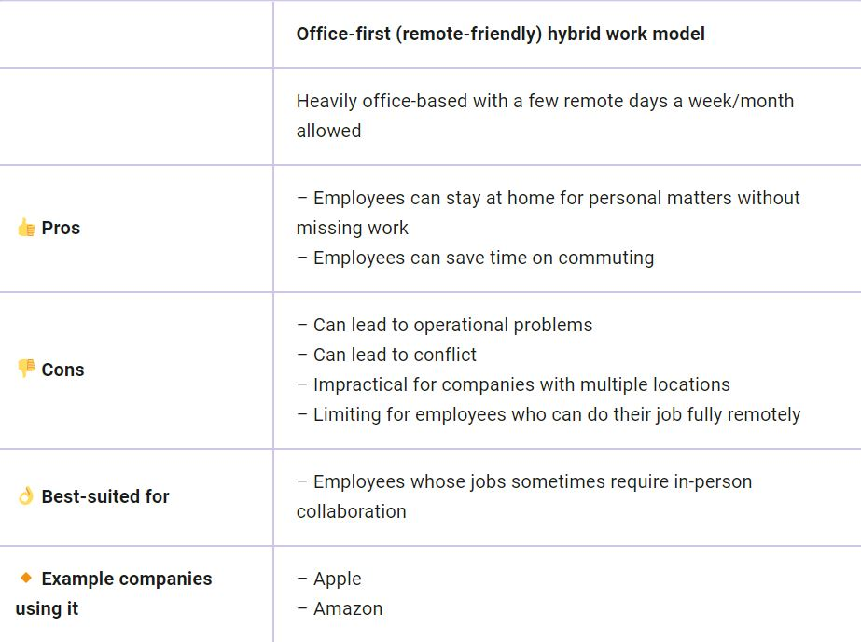
Types of remote work
https://pumble.com/blog/hybrid-remote-work-models/#:~:text=In%20the%20partly%20remote%20%28also%20known%20as%20remote-ish%29,43%25%20of%20respondents%20work%20within%20such%20a%20model.

Slide 22
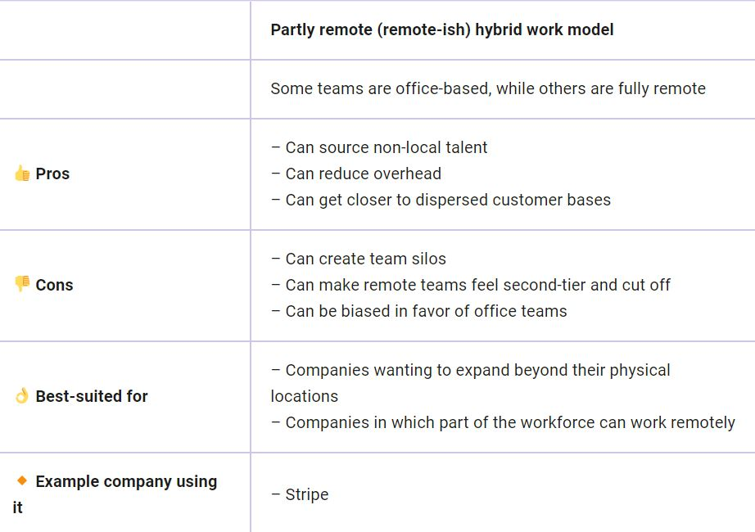
Types of remote work
https://pumble.com/blog/hybrid-remote-work-models/#:~:text=In%20the%20partly%20remote%20%28also%20known%20as%20remote-ish%29,43%25%20of%20respondents%20work%20within%20such%20a%20model.

Slide 23
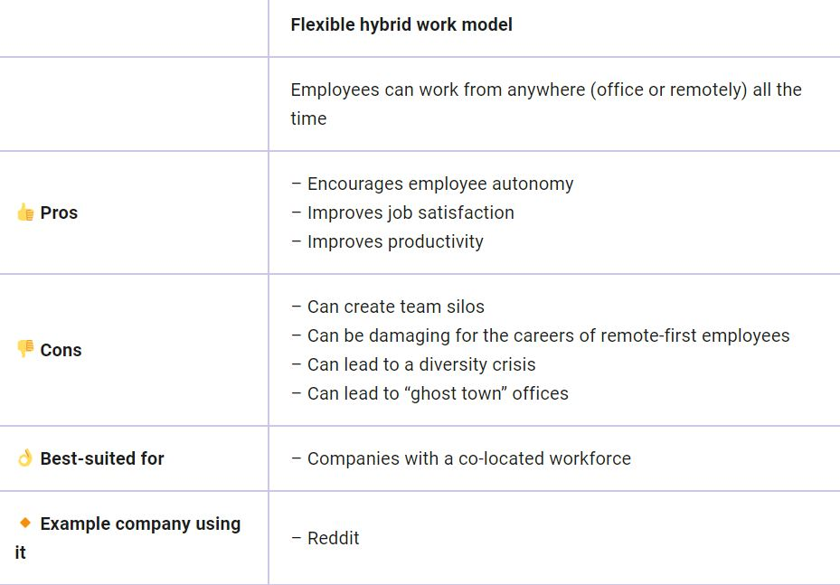
Types of remote work
https://pumble.com/blog/hybrid-remote-work-models/#:~:text=In%20the%20partly%20remote%20%28also%20known%20as%20remote-ish%29,43%25%20of%20respondents%20work%20within%20such%20a%20model.

Slide 24
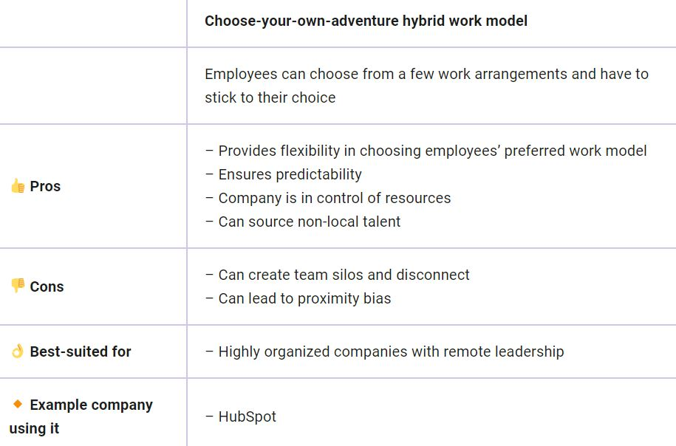
Types of remote work
https://pumble.com/blog/hybrid-remote-work-models/#:~:text=In%20the%20partly%20remote%20%28also%20known%20as%20remote-ish%29,43%25%20of%20respondents%20work%20within%20such%20a%20model.

Slide 25
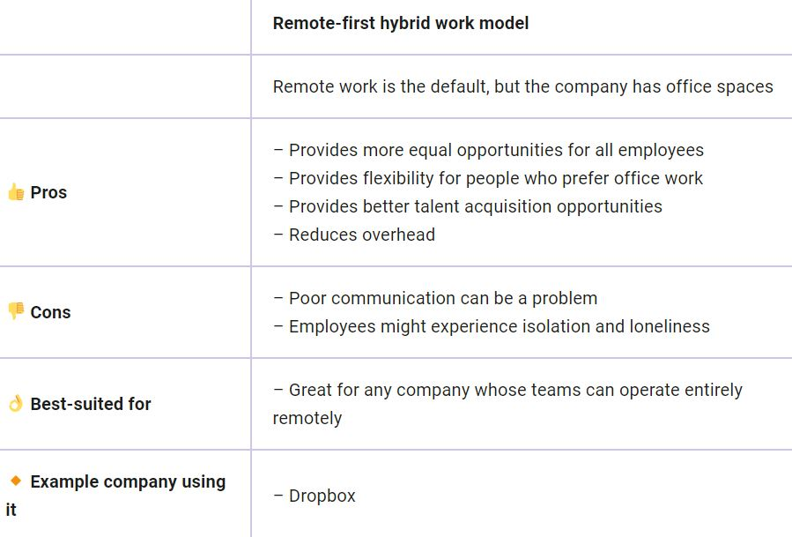
Types of remote work
https://pumble.com/blog/hybrid-remote-work-models/#:~:text=In%20the%20partly%20remote%20%28also%20known%20as%20remote-ish%29,43%25%20of%20respondents%20work%20within%20such%20a%20model.

Slide 26
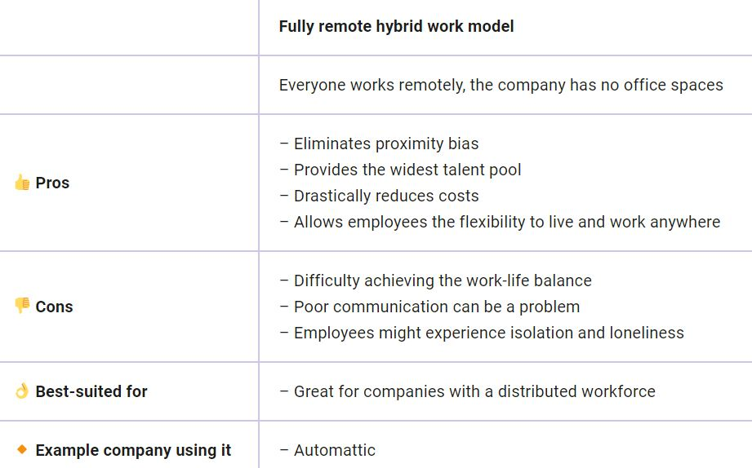
Types of remote work
https://pumble.com/blog/hybrid-remote-work-models/#:~:text=In%20the%20partly%20remote%20%28also%20known%20as%20remote-ish%29,43%25%20of%20respondents%20work%20within%20such%20a%20model.

Slide 27
There’s no one-size-fits-all work model. When deciding on the right option for your business, it’s best to examine the pros and cons of each of them, consider your organization’s unique needs, and mix and match the elements you like. Ultimately, you won’t know what works for you until you try it, so march on bravely into the hybrid future of work, and don’t worry if the model you’ve chosen is not ideal — you can adjust it in the process.

Slide 28
Activity 3: My teamwork is ...
Choose 1 type of remote work to start with your team and explain why.

Slide 29
Did you know that great employee onboarding can improve employee retention by 82%?

Slide 30
Onboarding for remote workers

Slide 31
Activity 4: Welcome to my team.

Slide 32
Remote employee onboarding checklist
Send information technology equipments to your new employee
Help new employees complete all of their paperworks
Send them the employee handbook
Make sure all software is installed
Introduce the new employee inside the company

Slide 33
Remote employee onboarding checklist
7
8
Train your remote employees
Set goals and expectationsw
Remoteemployee team building
9
0
Create consistent check-ins
Arrange an in-person meetings

Slide 34
Remote work is new, which makes remote management uncharted territory. You can overcome the challenges of managing a remote team with an openness to learning and receiving feedback.
Whether full-time or hybrid, with the right technology and employee engagement solutions, managing remote workers can be just as rewarding—and productive—as managing an in-house team.
A Guide for Remote Managers: Seven Strategies to Improve Remote Management — Remote Habits

Slide 35
Reflections
My next move.
A Guide for Remote Managers: Seven Strategies to Improve Remote Management — Remote Habits

Slide 36
"The European Commission's support for the production of this publication does not constitute an endorsement of the contents, which reflect the views only of the authors, and the Commission cannot be held responsible for any use which may be made of the information contained therein.” Project Number: 2021-1-SE01-KA220-VET-000032922

